Slide 1

COMS 3009/10/28A Software Design
University of the Witwatersrand, Johannesburg
School of Computer Science and Applied Mathematics

Slide 2
Who am I?
Name | Mr. Lucky Nkosi
Email | lucky@bbd.co.za
Consultation Hours: | Tuesday 11:30 – 13:30
Consultation Bookings | Booking Link (bit.ly/consultLucky)

Slide 3

Course Outline

Slide 4
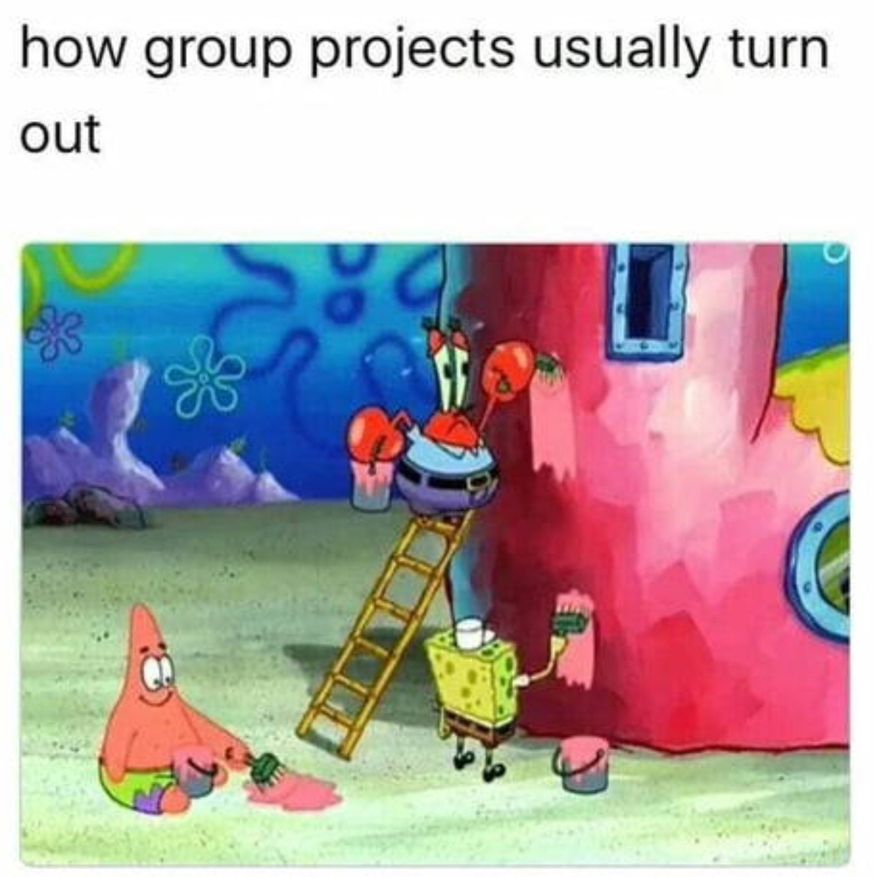
Project
Choose groups of around 4-6 people.
Use the next week choose your groups
A list of projects will be out as soon as possible
Each group must select 3 different choices in descending
order of preference.
You will be allocated a project with your selection in mind
Projects will be conducted using the Scrum methodology.

Slide 5
Assessment Structure

Slide 6
Assessment Structure
Class Tests | 30%
Project | 15%
Project x Lab Assessments | 15%
Exam | 40%

Slide 7
What is Software Design?

Slide 8
What is Software Design?
Software design involves problem solving and planning a software solution. This
includes low-level component and algorithm design and a high-level
architectural design. The following are some common aspects of software design:
Requirements gathering
Object-oriented design
Design patterns
Architectural patterns
Testing

Slide 9
Software Design

Slide 10
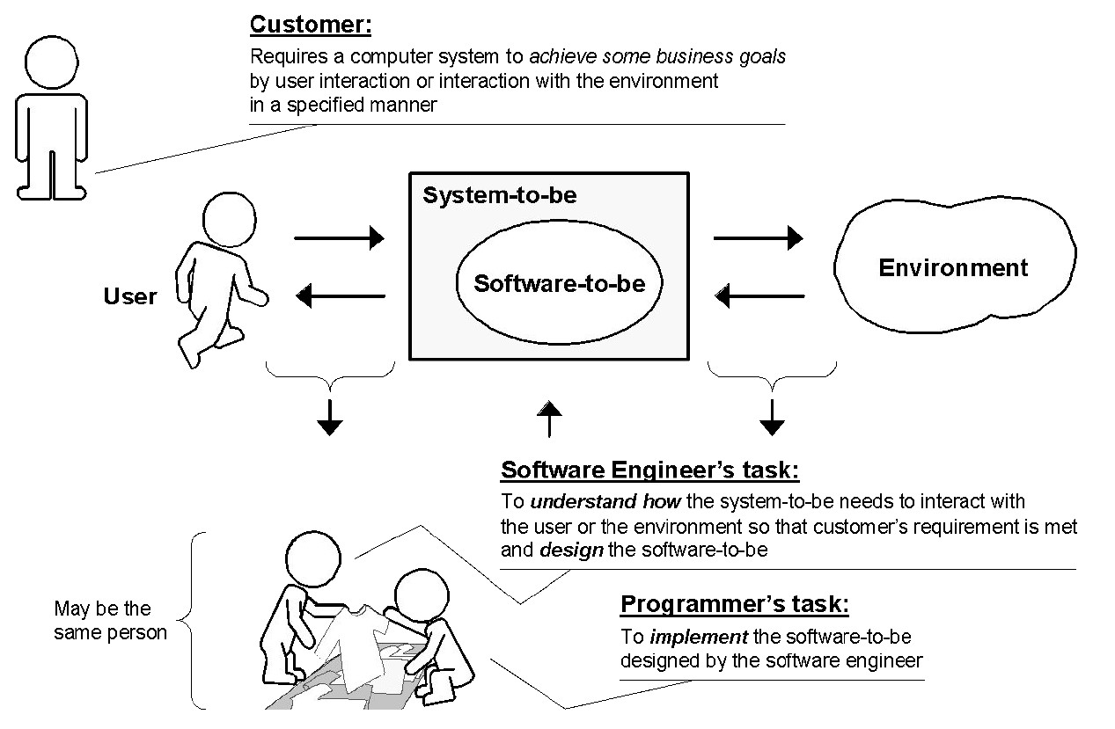
The Role of a Software Engineer

Slide 11
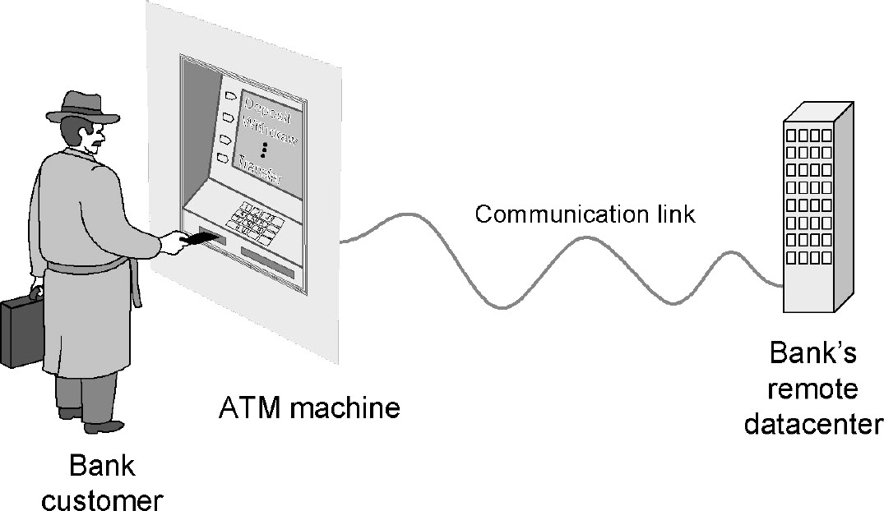
Example: ATM Machine

Slide 12
Solving the Problem
Divide and Conquer:
Identify logical parts of the system that each solves a part of the problem
Easiest done with the help of a domain expert who already knows the steps in the process (“how it is currently done”)
Result: Model of the problem domain

Slide 13
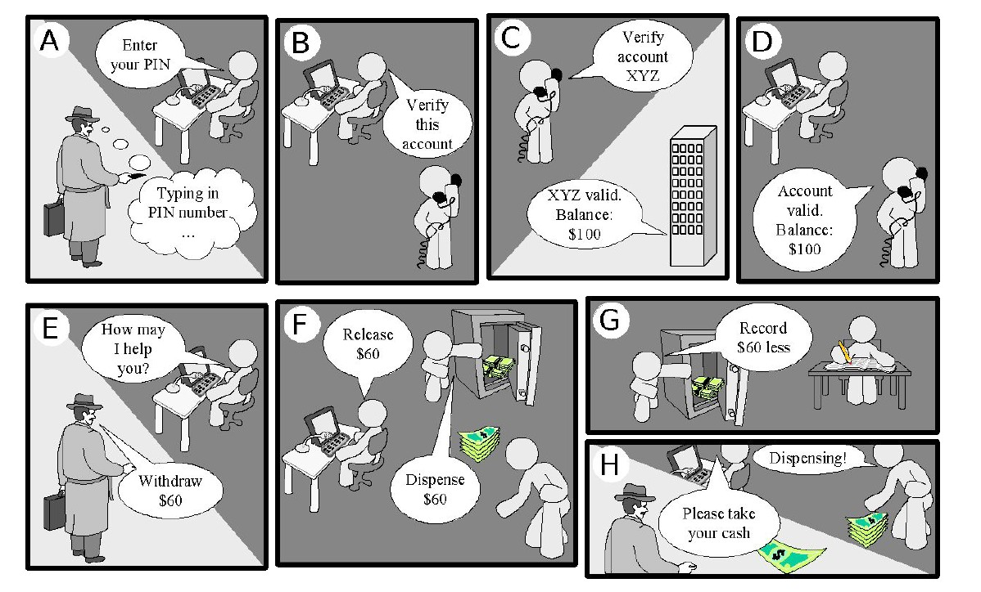
Example: ATM Machine

Slide 14
Understanding the Problem Domain
Actors
Agents external to the system that interact with it
Concepts/Objects
Agents working inside the system to make it function
User stories
Scenarios for using the system

Slide 15
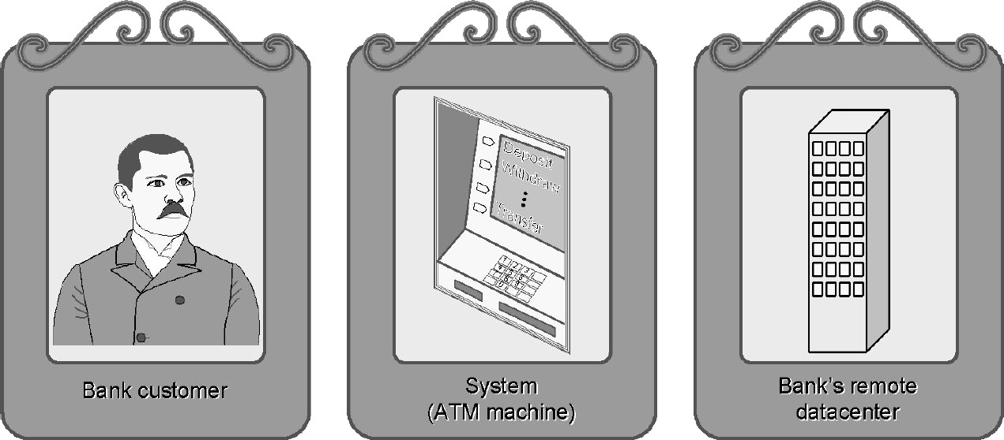
Example: ATM Machine
Actors
Usually easy to identify
Most visible parts of the equation

Slide 16
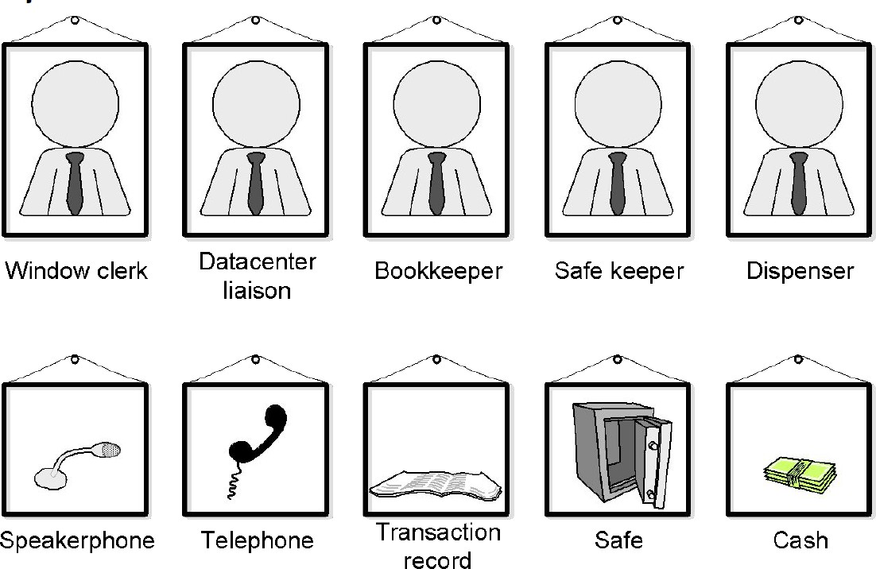
Example: ATM Machine
Concepts
Hard to identify
Conceptual parts of a system

Slide 17
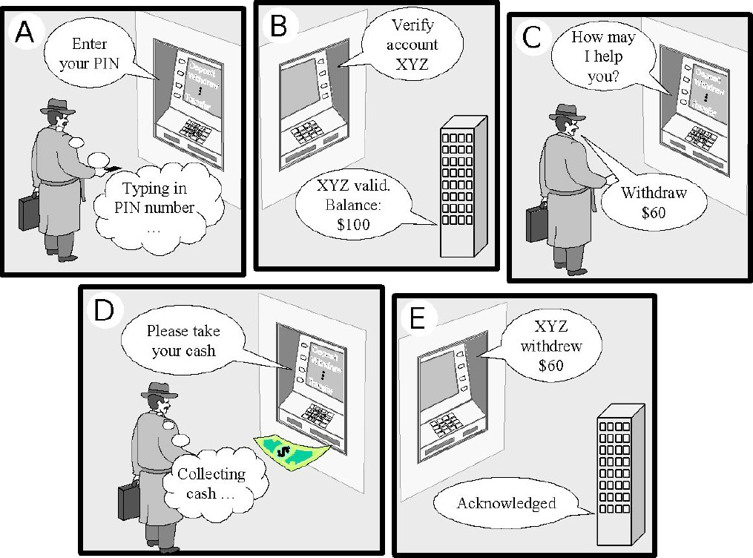
Example: ATM Machine
User stories

Slide 18
Software Development Methods

Slide 19
Software Development Methodologies
Strategy employed to create the software solution
3 main methods
Waterfall
Iterative & Incremental
Agile

Slide 20
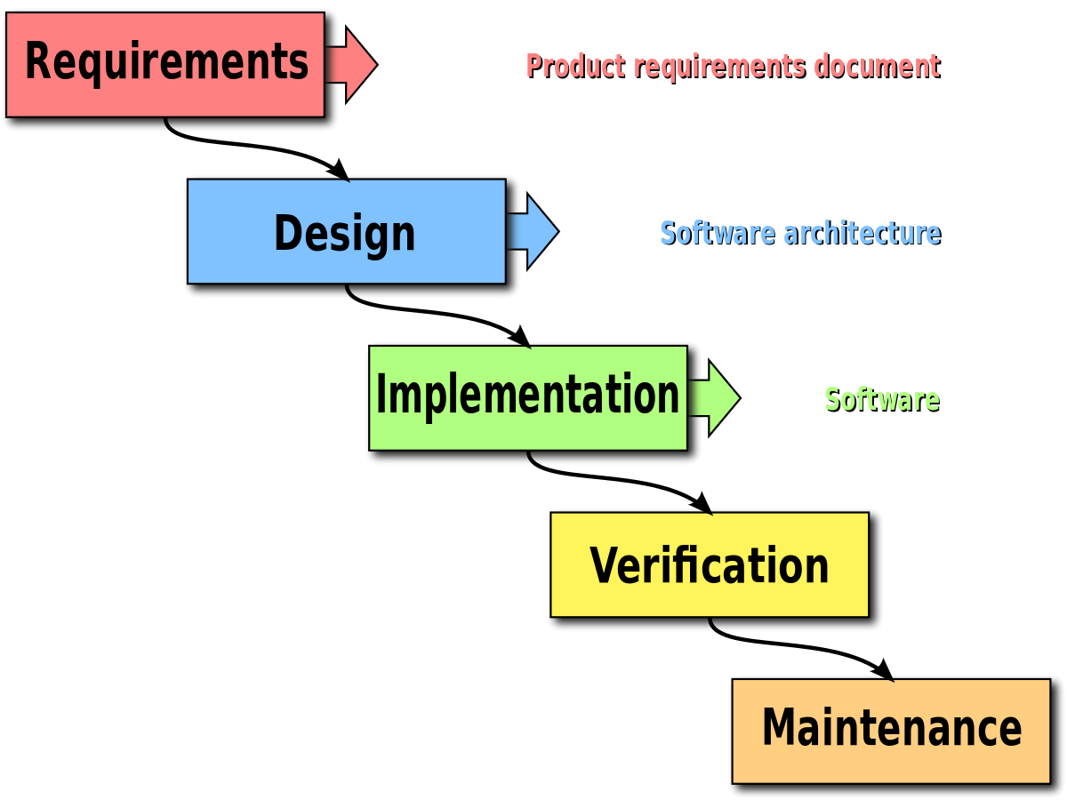
Waterfall
One phase after another
Unidirectional
Pros:
Simple to come up with
Easy to manage
Cons:
Only have a working product at the very end
Hard to revise; locked in after planning
High risk, high uncertainty
Does not incorporate feedback
Not suitable for larger systems

Slide 21
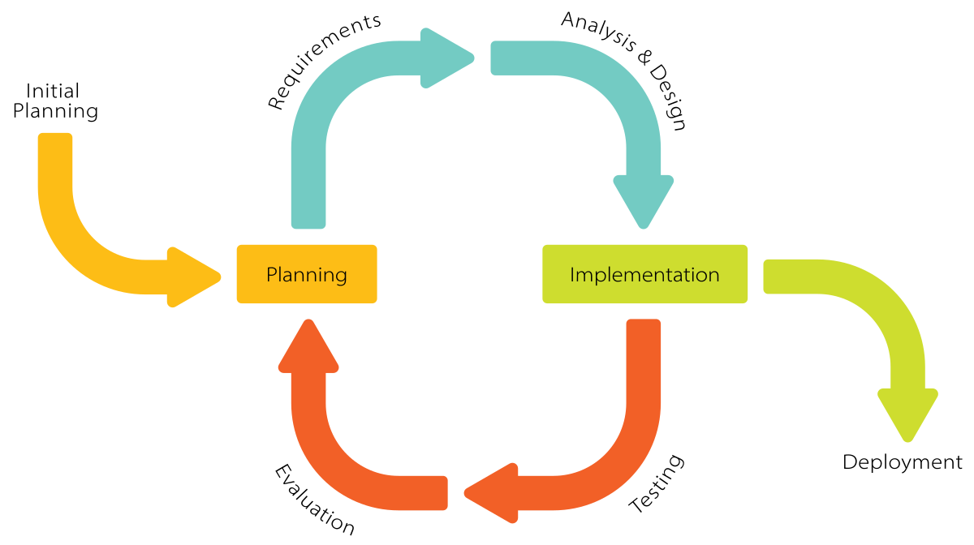
Iterative and Incremental
Create a Minimum Viable Product (MVP), and incrementally add to it
Increments defined by amount of work to be done
Repeat until product is done
Pros:
Get minimum viable product (MVP) out sooner
Can work in order of priority
Can accommodate requirements changes
Client can give feedback after every iteration
Cons:
Harder to manage
Initial planning must be efficient as every increment must work with future increments
Defining increments can be difficult

Slide 22

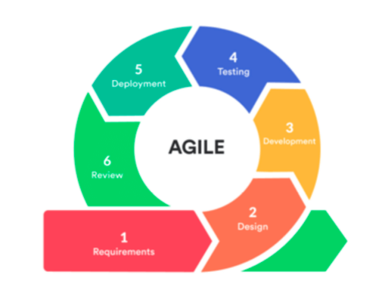
Agile
Build on Iterative and Incremental
Increments are defined by timed intervals
Not so much planning, focus more on immediate requirements
Focus on collaboration
Pros:
Early and frequent releases
Can accommodate changing requirements
Constant feedback
Simple
Cons:
Can be difficult to constantly meet with client
Requires more discipline to meet time goals
Time estimation needs to be good

Slide 23
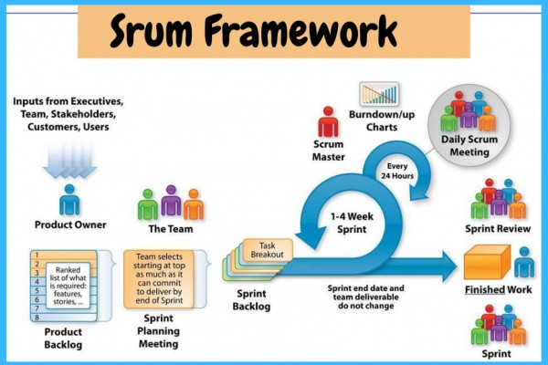

Slide 24
Scrum
Development Team
Developers, Analysts, Designers, Domain Experts, etc.
Autonomy on how to develop increment
Collaborative
Product Owner
Responsible for vision
Final arbiter on requirements
Reprioritises backlog constantly
ScrumMaster
Part of the dev team
Helps facilitate the scrum process
Ensures the team works together smoothly
Is a leader, but not a manager

Slide 25
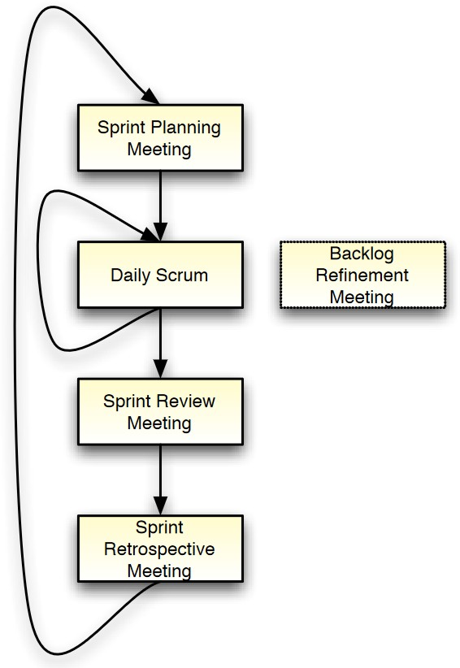
Scrum Ceremonies
Sprint Planning
Daily Scrum
Sprint Review
Sprint Retrospective
Backlog Refinement

Slide 26
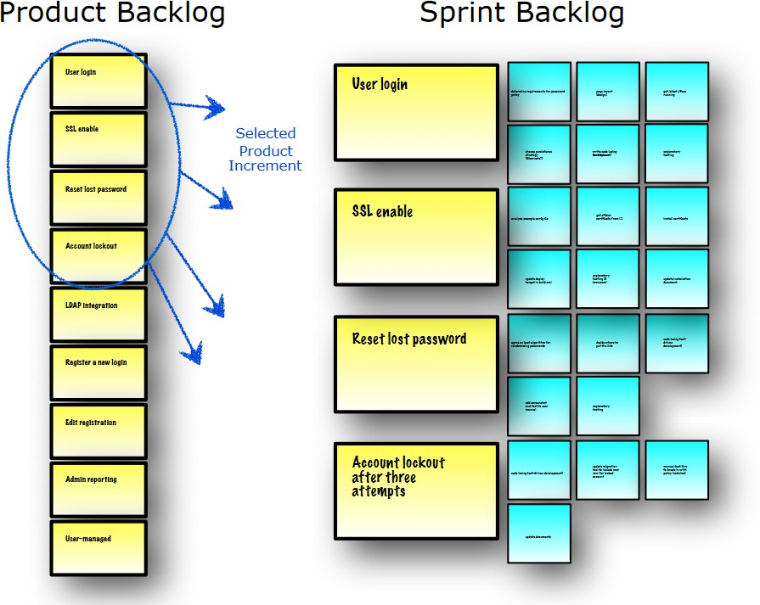
Scrum
Sprint Planning
Product Backlog: list of requirements (user stories)
Dev team and product owner work together to pull backlog items into the sprint
Break each backlog item into tasks
Need to estimate how many backlog items to do in time window
Need to prioritise certain backlog items over others

Slide 27
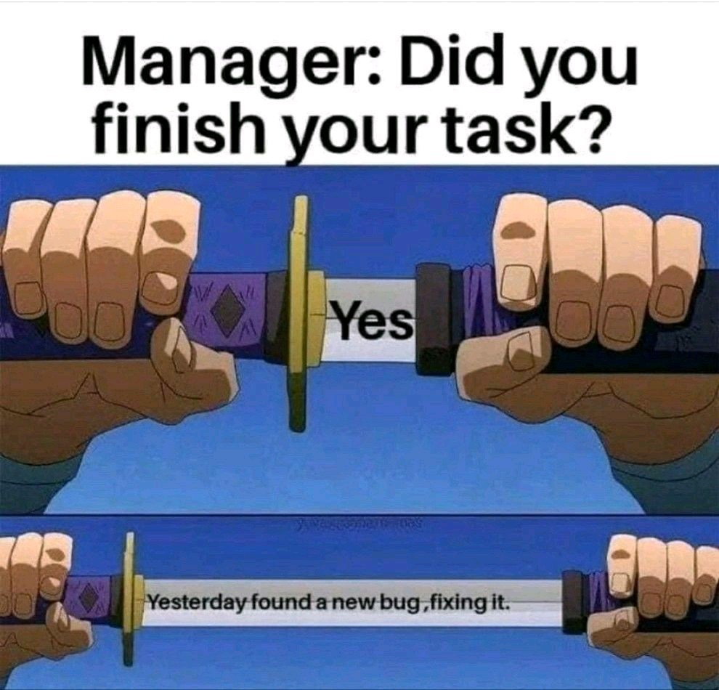
Scrum
Daily Scrum (standup)
~15 minutes every day
Create plan for today
Discuss goals, impediments, etc.
What did I do yesterday? What did I do today?
Are there any impediments?
Commitment to you and your team
Can be over WhatsApp/Discord/etc. I will be checking

Slide 28
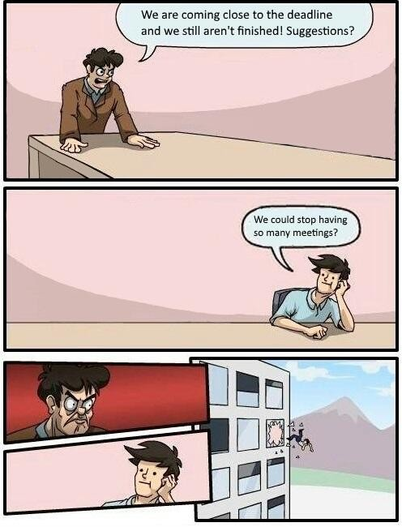
Scrum
Sprint Review
Meet with product owner
Live demo of current version of product
Product owner determines which backlog items are done
Code complete
Deployed to appropriate env
Adequately tested Feedback

Slide 29
Scrum
Sprint Retrospective
Reflect on how the last sprint went
How can the team improve?
Needs to be transparent and a safe space for all devs
Avoid blaming

Slide 30
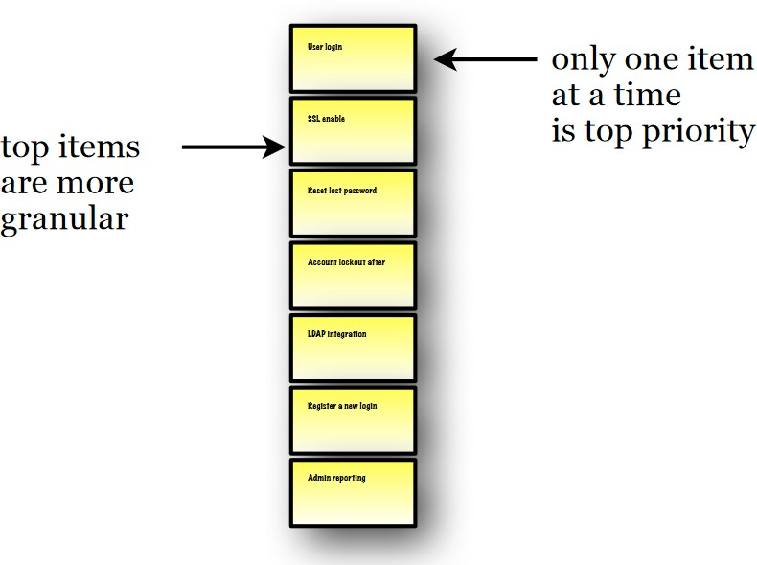
Scrum
Backlog Refinement
Take the product backlog and refine it
Break down large items into smaller ones
Smaller, evenly-sized tasks are easier to estimate times for
Adjust estimates based on progress
Reassess priorities
Prune unnecessary items

Slide 31

Scrum
Check resources on Moodle for more information
Videos on the scrum process
Scrum reference card
Recommended software:
Github Projects
Monday
Trello
Taiga
Notion

